Slide 1
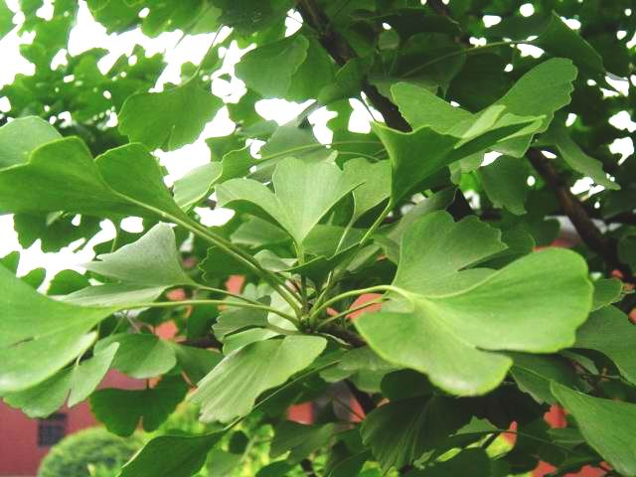
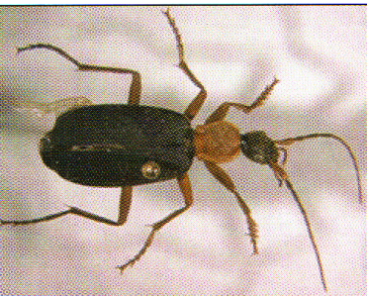
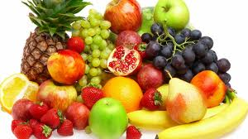
Ginkgo tree
Galerita beetle
SECTION VIII (CHAP 21)
CARBOXYLIC ACIDS AND DERIVATIVES

Slide 2
FUNDAMENTAL CONCEPTS
Naming carboxylic acids
Synthesis of carboxylic acids
Conversion of carboxylic acids
Acyl halides: Naming and interconversion
Anhydrides: Naming and interconversion
Esters: Naming and interconversion
Esters: Naming and interconversion
Nitriles: Naming and interconversion

Slide 3
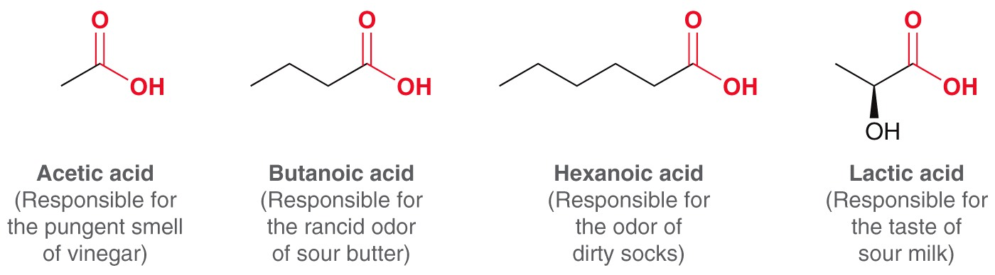
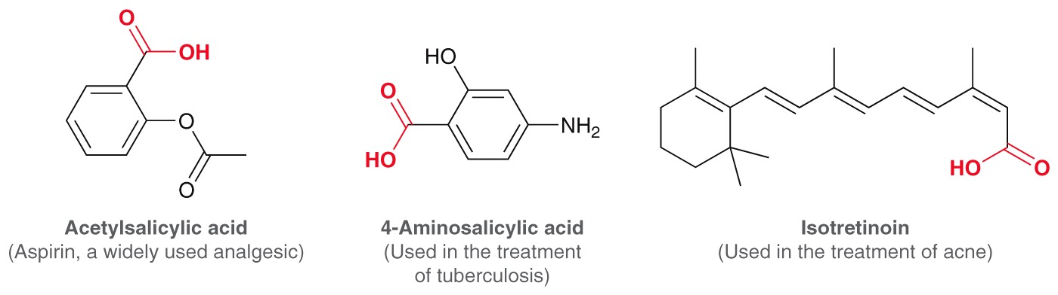
CARBOXYLIC ACIDS
Carboxylic acids are abundant in nature and in pharmaceuticals

Slide 4
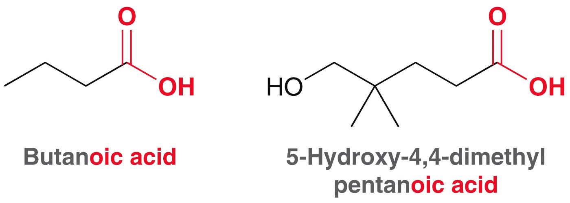
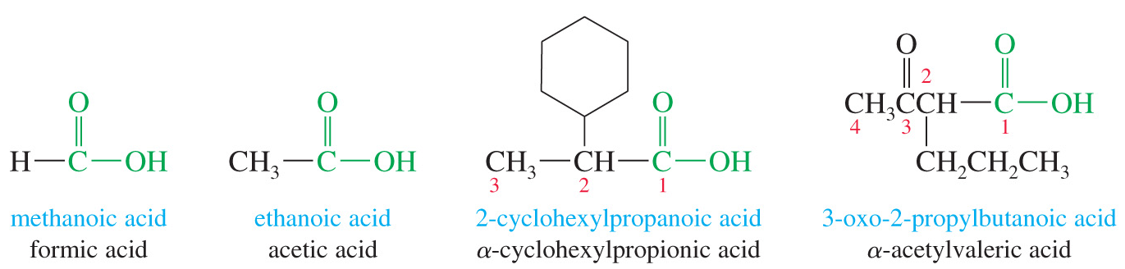
NOMENCLATURE
IUPAC Names
The IUPAC nomenclature for carboxylic acids uses the alkane name that corresponds to the longest continuous chain of carbon atoms.
Remove -e from alkane (or alkene) name, add -oic acid.
The carbon of the carboxyl group carries the number 1

Slide 5
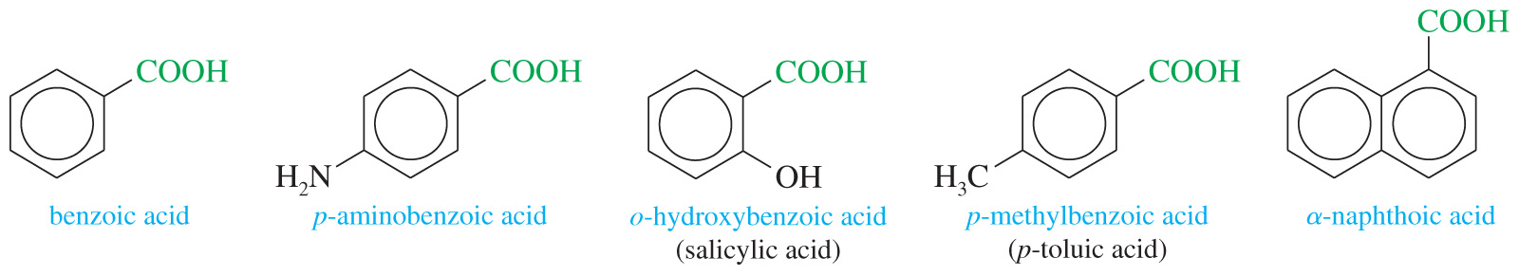
NOMENCLATURE
Unsaturated Acids
Remove the final -e from alkene or alkyne name, add the ending -oic acid.
Aromatic Acids
Aromatic acids are named as derivatives of benzoic acid.
Ortho-, meta- and para- prefixes are used to specify the location of a second substituent.
Numbers are used to specify locations when more than 2 substituents are present

Slide 6
NOMENCLATURE
Dicarboxylic Acids
For IUPAC name, number the chain from the end closest to a substituent
Cyclic carboxylic acid

Slide 7
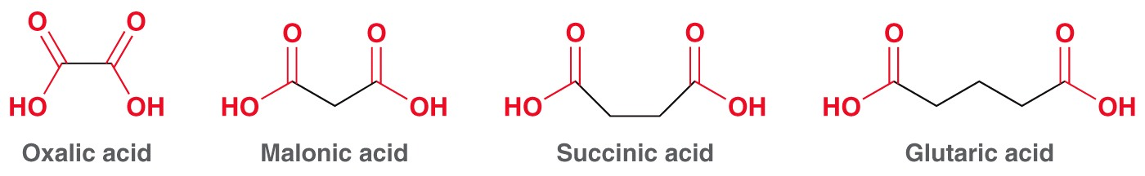
NOMENCLATURE
Common names for dicarboxylic acids
Examples: Name the following compounds
Practice 21.1 to 21.3 P. 987
Problems 21.41 to 21.44 P. 1038

Slide 8
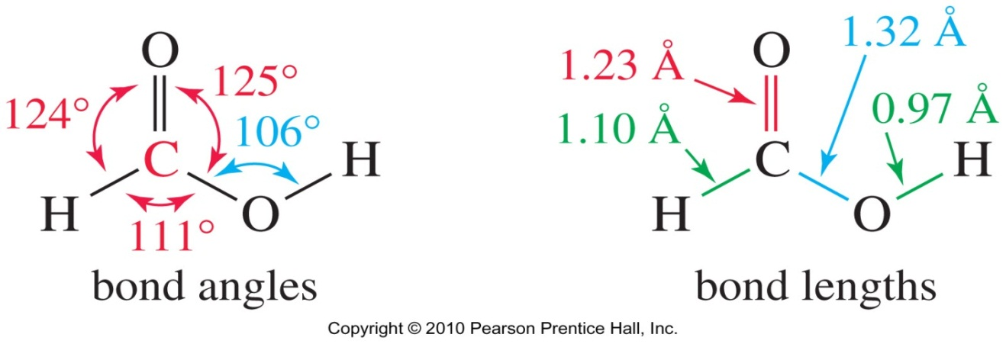
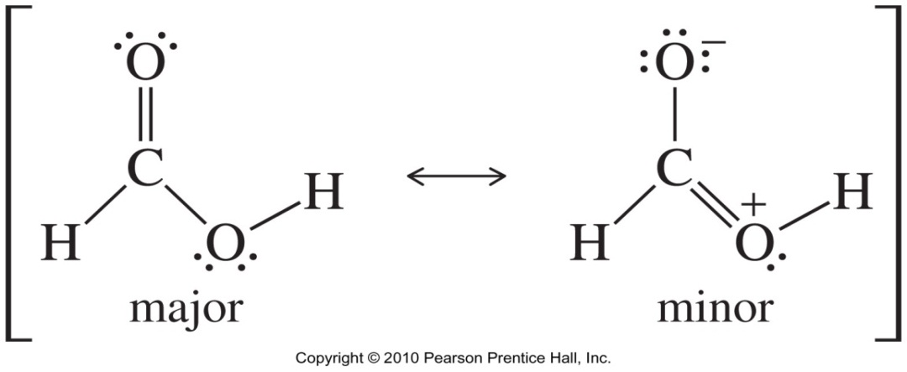
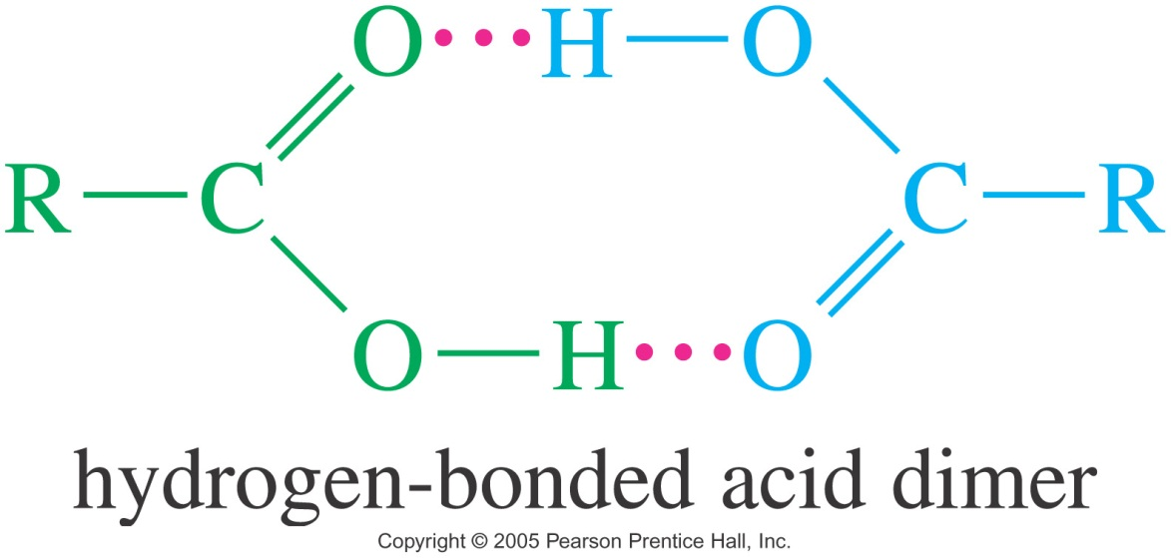
PHYSICAL PROPERTIES
Structure of Carboxyl
Boiling Points
Carboxylic acids boil at considerably higher boiling points than alcohols, ketones or aldehydes of similar molecular weights, due to dimer formation.

Slide 9
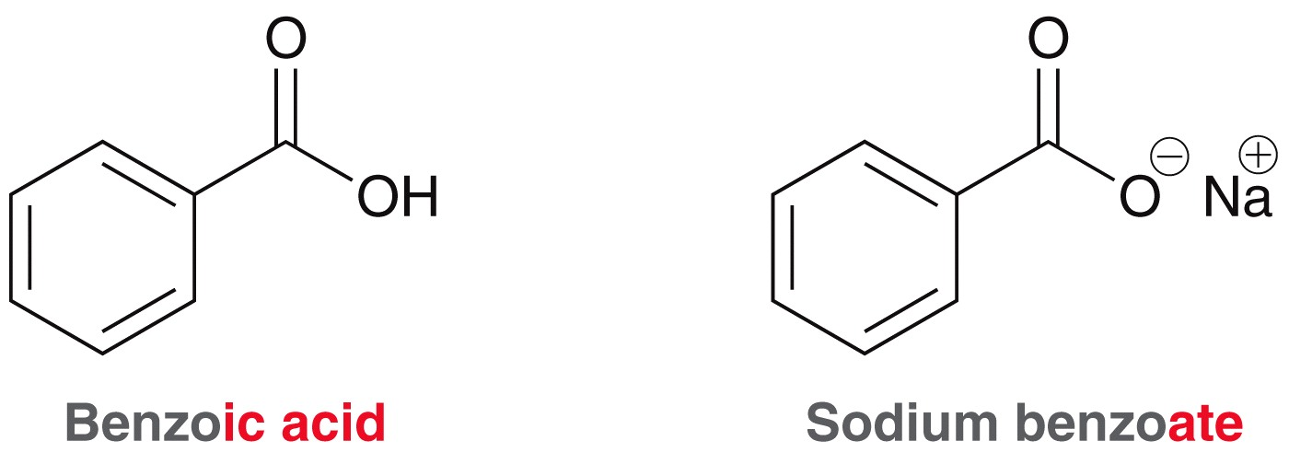
CHEMICAL PROPERTIES
Solubility
Water solubility decreases with the length of the carbon chain.
With up to 4 carbons, acid is miscible in water. Very soluble in alcohols.
Also soluble in relatively nonpolar solvents like chloroform because the hydrogen bonds of the dimer are not disrupted by the nonpolar solvent
Acidity of Carboxylic Acids
A carboxylic acid may dissociate in water to give a proton and a carboxylate ion
The equilibrium constant Ka for this reaction is called the acid-dissociation constant
The acid will be mostly dissociated if the pH of the solution is higher than the pKa of the acid.

Slide 10
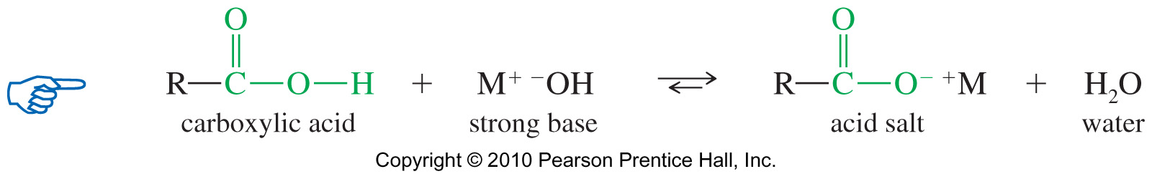
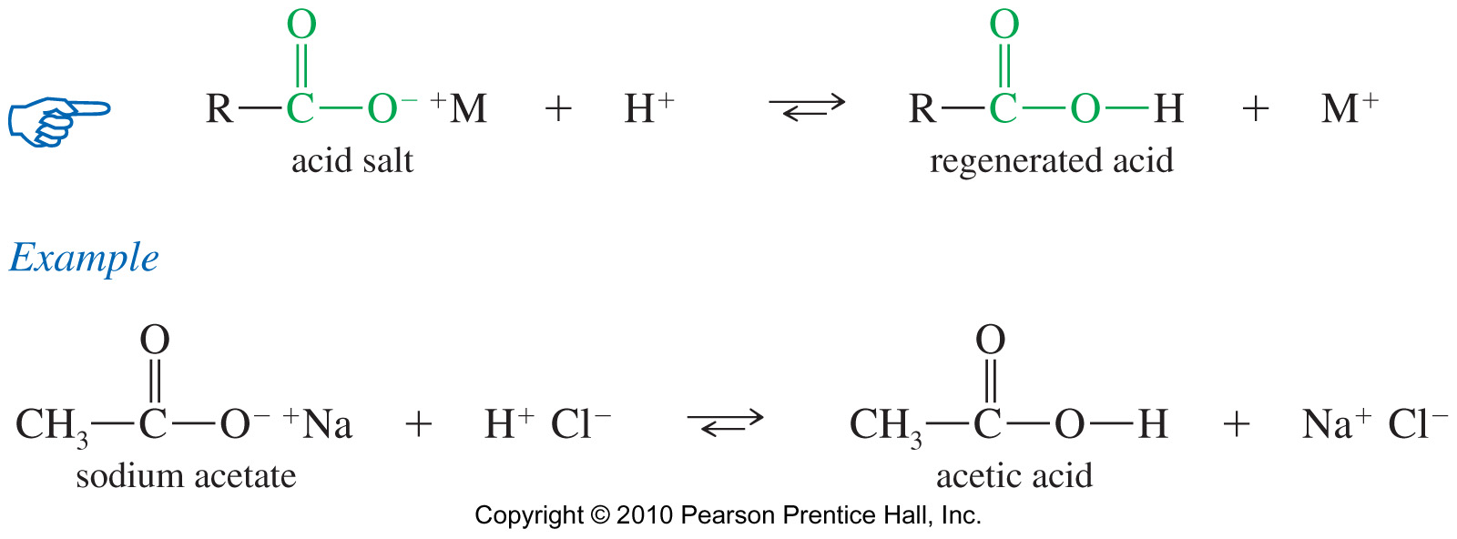
CHEMICAL PROPERTIES
Deprotonation of Carboxylic Acids
The hydroxide ion deprotonates the acid to form the carboxylate salt.
Adding a strong acid, like HCl, regenerates the carboxylic acid

Slide 11
CHEMICAL PROPERTIES
Naming Carboxylic Acid Salts
Salts of carboxylic acids are named simply by naming the cation, then naming the carboxylate ion by replacing the terminal –ic acid by –ate.
Properties of Acid Salts
Usually solids with no odor.
Carboxylate salts of Na⁺, K⁺, Li⁺, and NH₄⁺ are soluble in water.
Soap is the soluble sodium salt of a long chain fatty acid
Salts can be formed by the reaction of an acid with NaHCO₃, releasing CO₂

Slide 12
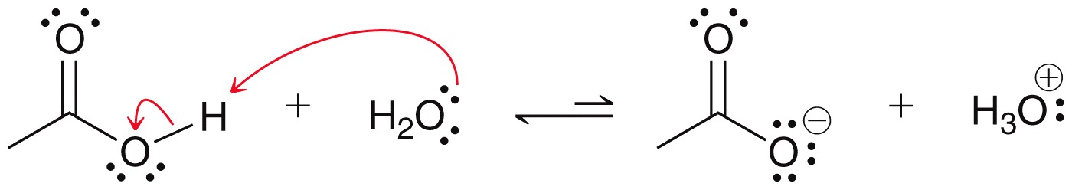
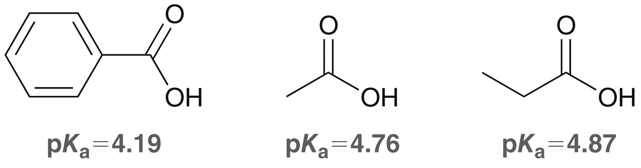
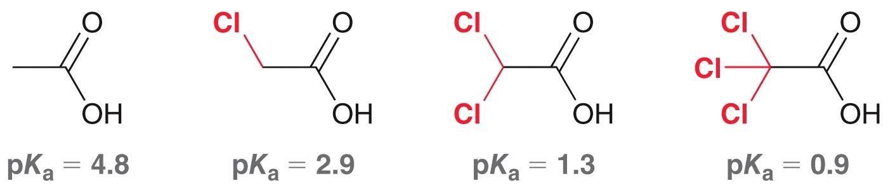
CHEMICAL PROPERTIES
Acidity of Carboxylic Acids
In water, the equilibrium generally favors the acid

Slide 13
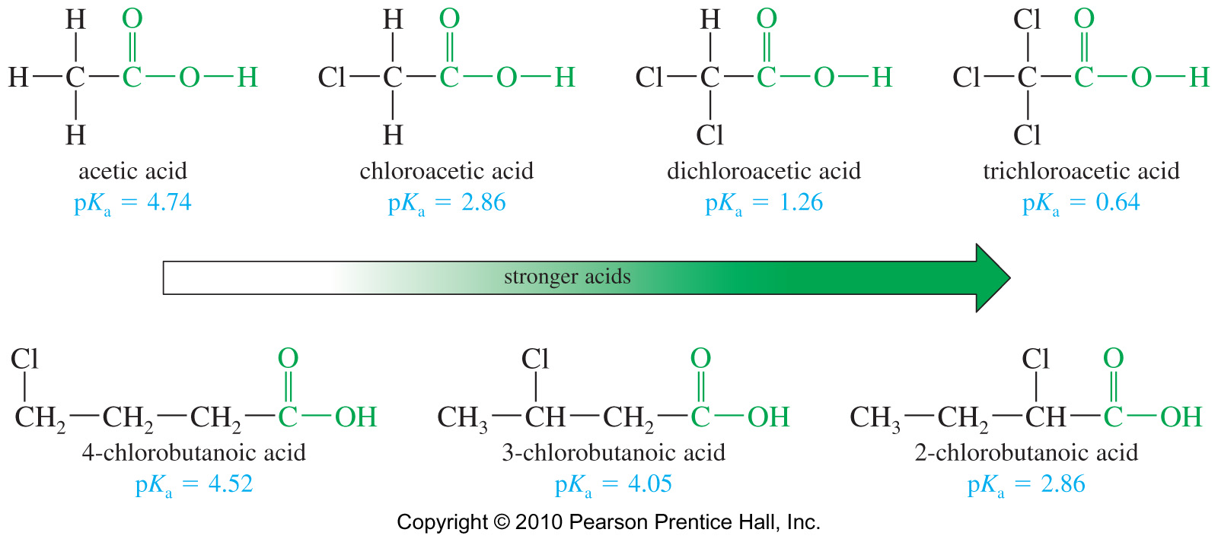
CHEMICAL PROPERTIES
Substituent Effects on Acidity
The magnitude of a substituent effect depends on its distance from the carboxyl group

Slide 14
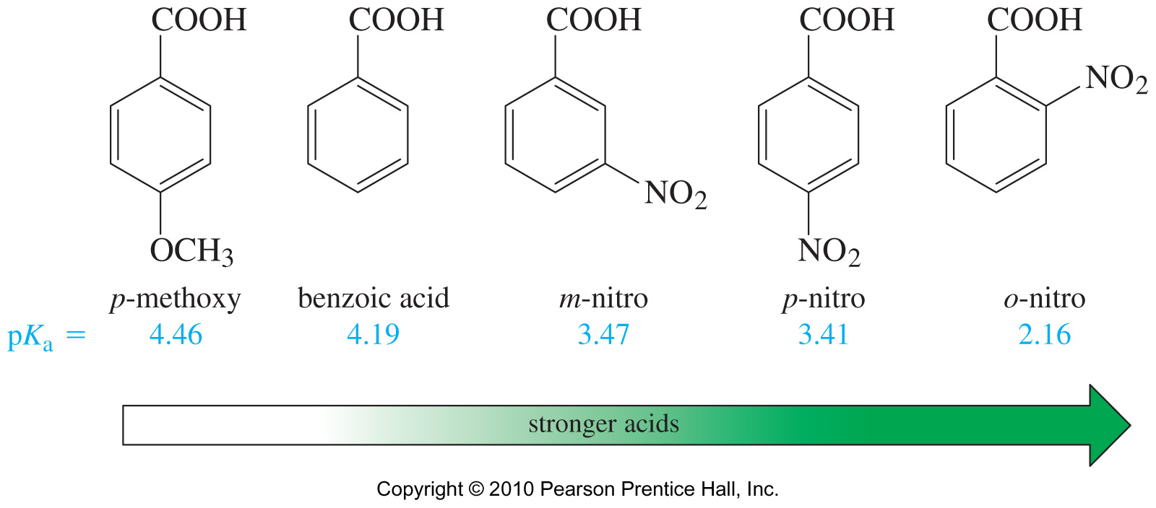
CHEMICAL PROPERTIES
Aromatic Carboxylic Acids
Electron-withdrawing groups enhance the acid strength and electron-donating groups decrease the acid strength.
Effects are strongest for substituents in the ortho and para positions
Problems 21.39 P. 1038

Slide 15
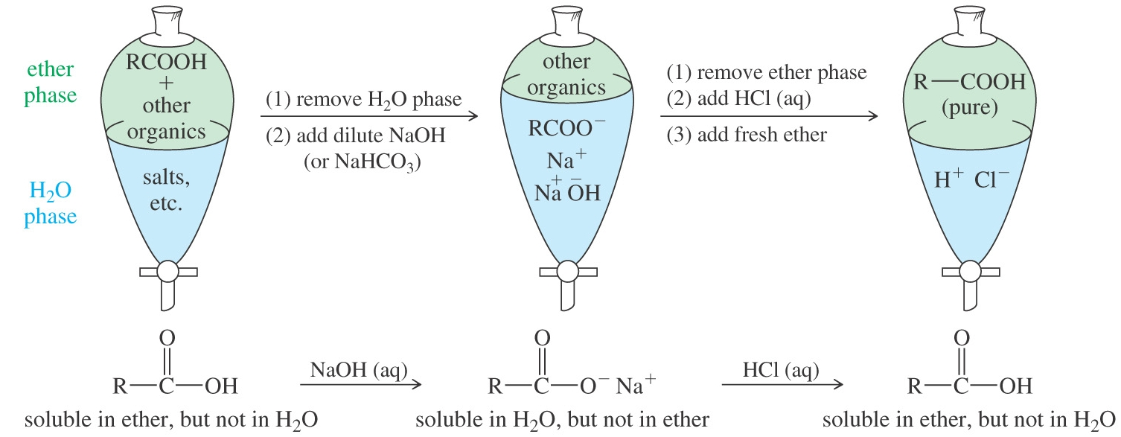
CHEMICAL PROPERTIES
Purifying an Acid
Some Important Acids
Acetic acid is in vinegar and other foods, used industrially as solvent, catalyst, and reagent for synthesis.
Fatty acids are found in fats and oils.
Benzoic acid is used in drugs as preservatives.
Adipic acid used to make nylon 66.
Phthalic acid used to make polyesters

Slide 16
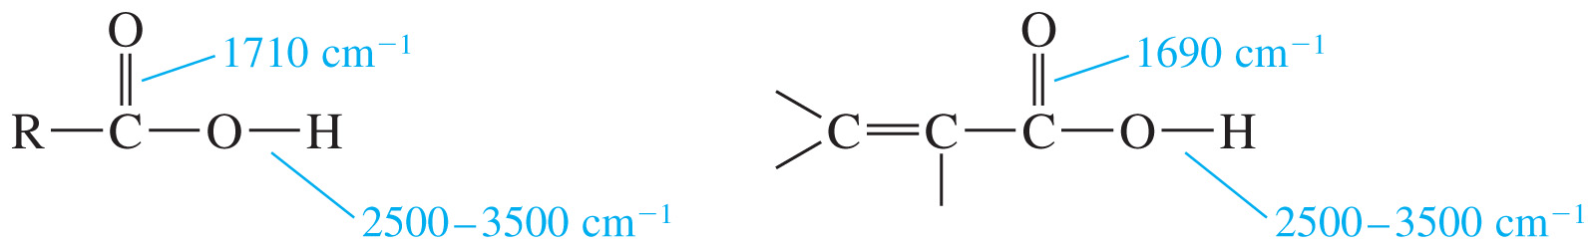
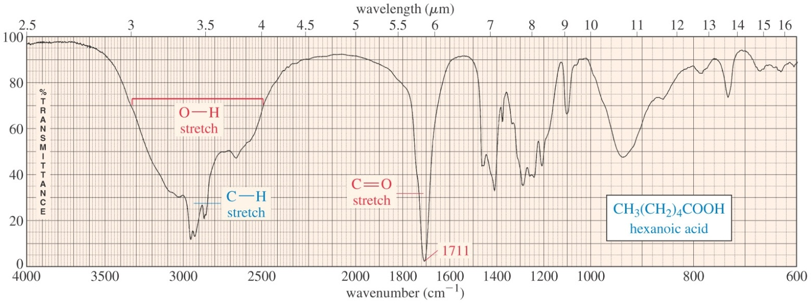
SPECTROSCOPY
IR Spectroscopy
There will be two features in the IR spectrum of a carboxylic acid: the intense carbonyl stretching absorption (1710 cm⁻¹) and the OH absorption (2500 –3500 cm⁻¹)
Conjugation lowers the frequency of the C═O band

Slide 17
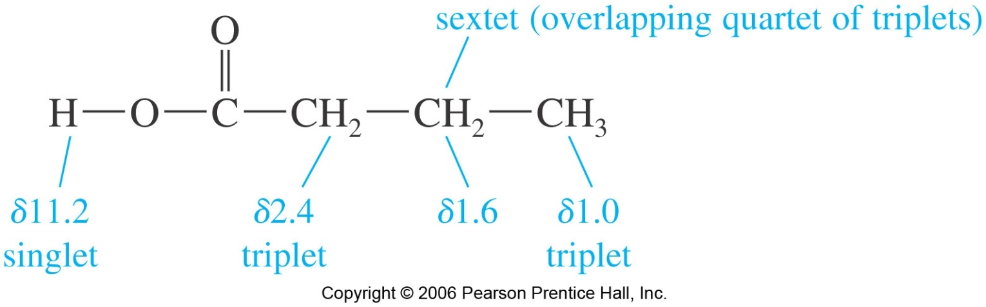
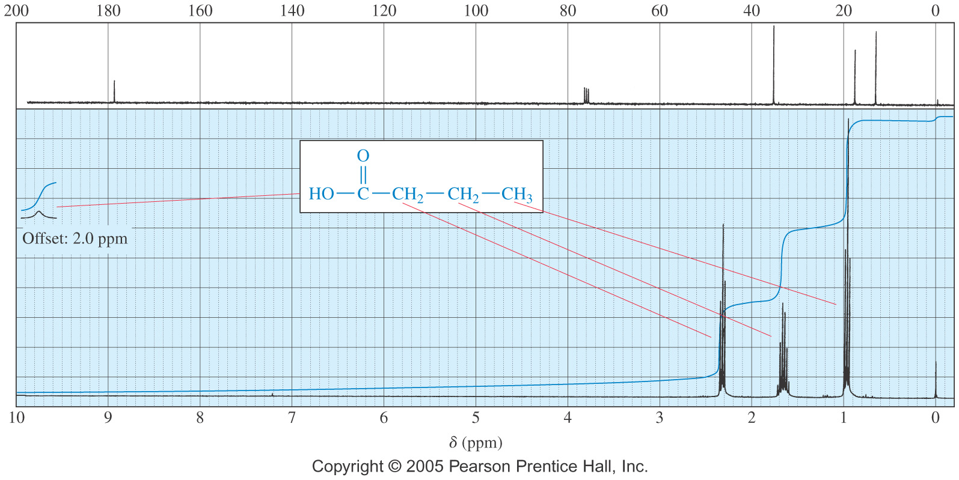
SPECTROSCOPY
NMR Spectroscopy
α

Slide 18
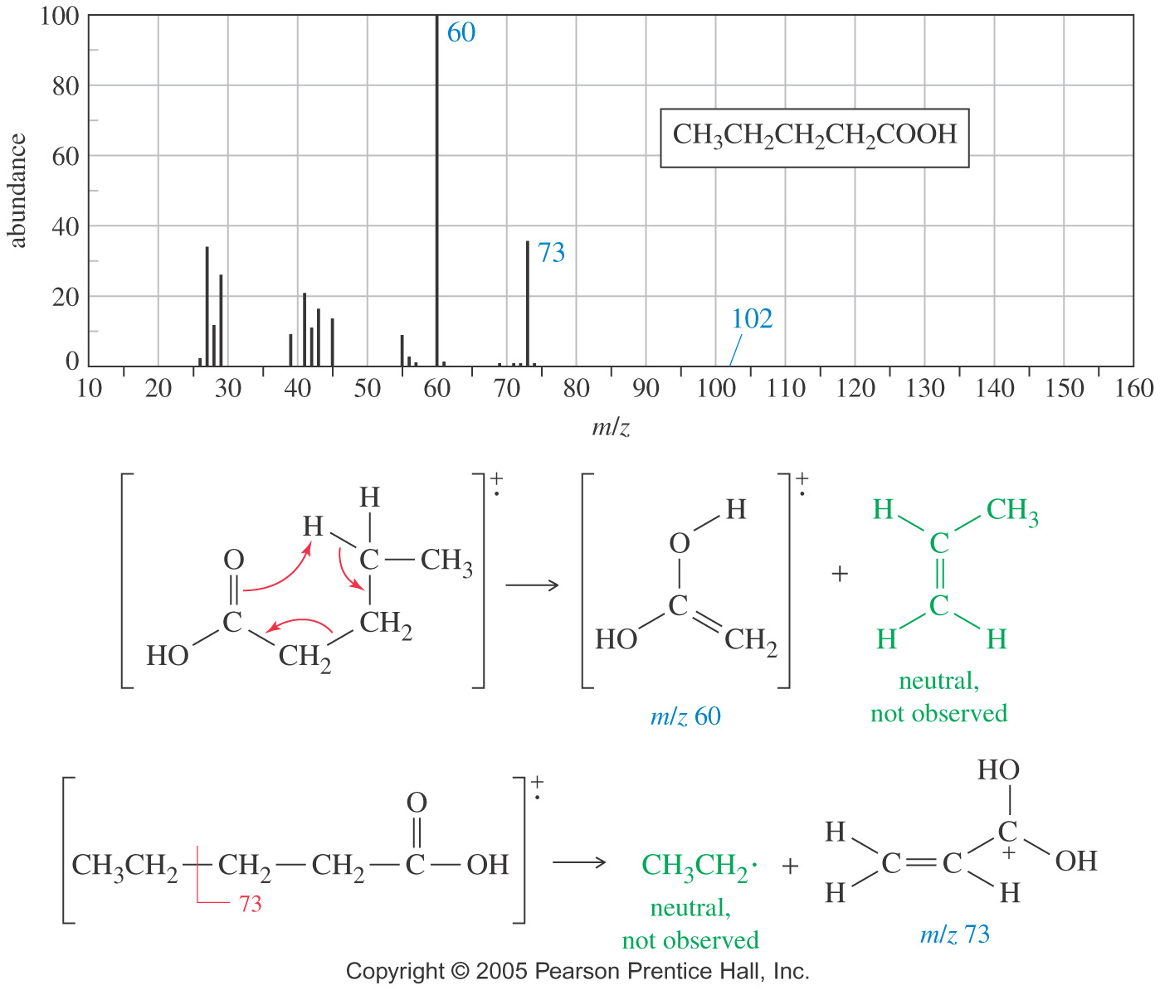
SPECTROSCOPY
Mass Spectrometry

Slide 19
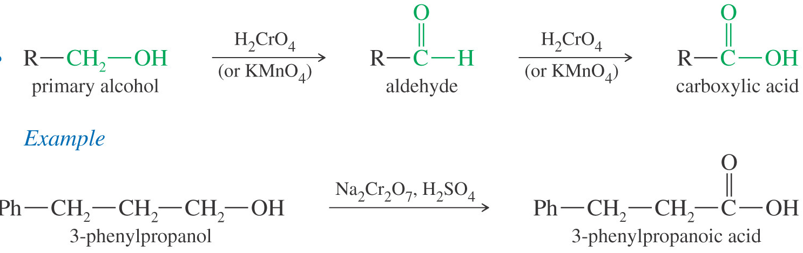
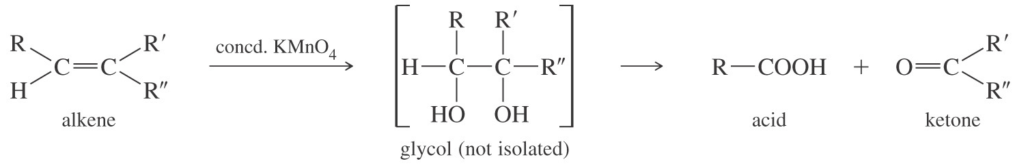
SYNTHESIS OF CARBOXYLIC ACIDS
Synthesis Review
Oxidation of primary alcohols and aldehydes with chromic acid.
Cleavage of an alkene with hot KMnO₄ produces a carboxylic acid if there is a hydrogen on the double-bonded carbon.
Cleavage of an alkyne with ozone or hot permanganate.
Alkyl benzene oxidized to benzoic acid by hot KMnO₄ or hot chromic acid.

Slide 20
SYNTHESIS OF CARBOXYLIC ACIDS
Synthesis Review
Cleavage of an alkyne with ozone or hot permanganate.
Alkyl benzene oxidized to benzoic acid by hot KMnO₄ or hot chromic acid.
Basic or acidic hydrolysis of a nitrile also produces a carboxylic acid.
Conversion of Grignards to Carboxylic Acids

Slide 21
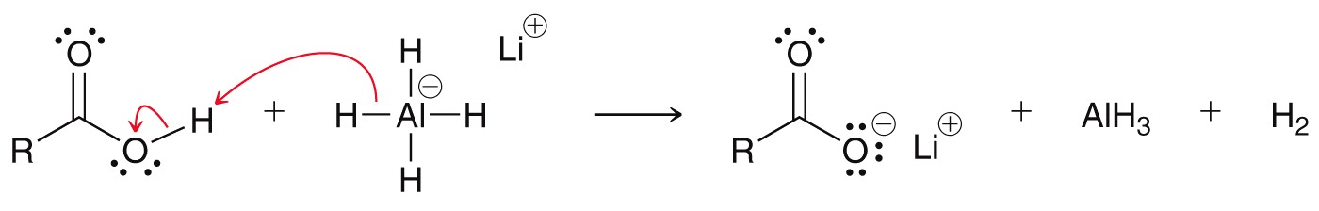
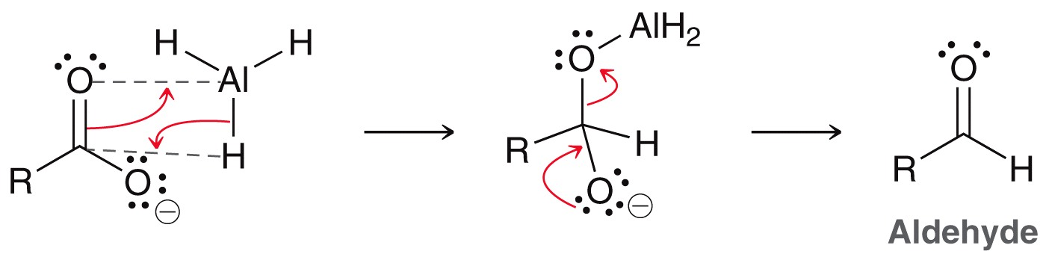
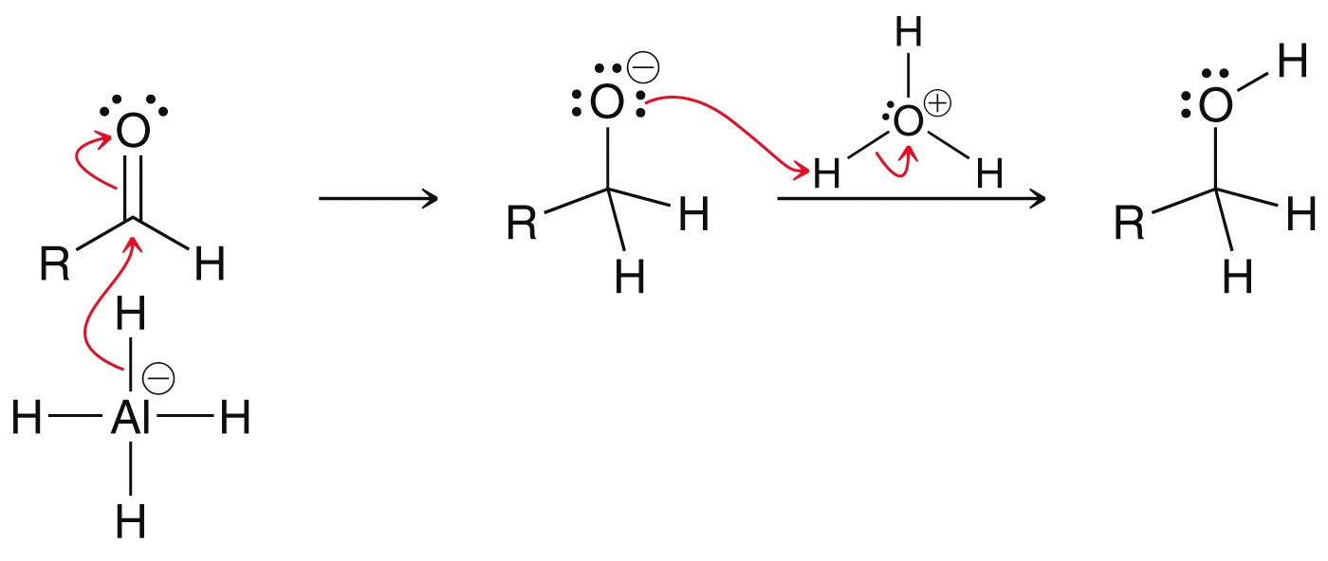
CONVERSION OF CARBOXYLIC ACIDS
Reduction to 1° Alcohols
LiAlH₄ reduces carboxylic acids to primary alcohols
The intermediate aldehyde reacts faster with the reducing agent than the carboxylic acid

Slide 22
CONVERSION OF CARBOXYLIC ACIDS
Reduction to 1° Alcohols
BH₃•THF (or B₂H₆) can also reduce the carboxylic acid to the alcohol, but does not reduce aldehydes or ketones.
B₂H₆ is unstable and must be kept in ether type of solvents such as THF

Slide 23
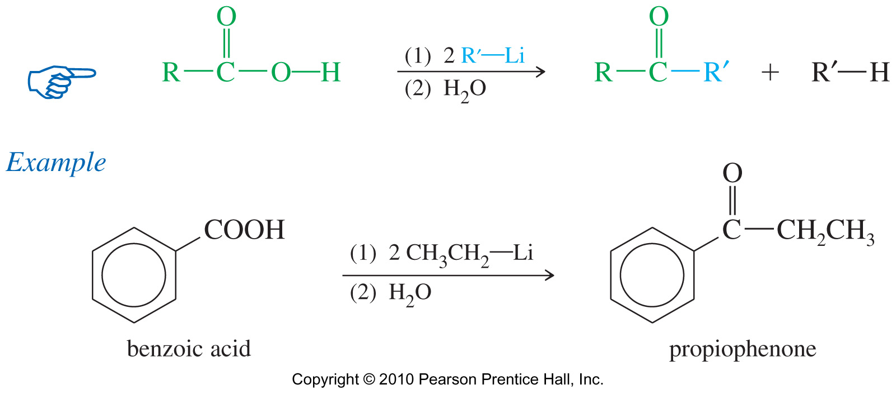
CONVERSION OF CARBOXYLIC ACIDS
Conversion of Carboxylic Acids to Ketones
A general method of making ketones involves the reaction of a carboxylic acid with two equivalents of an organolithium reagent

Slide 24
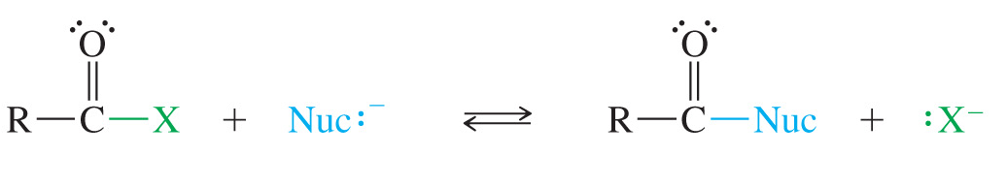
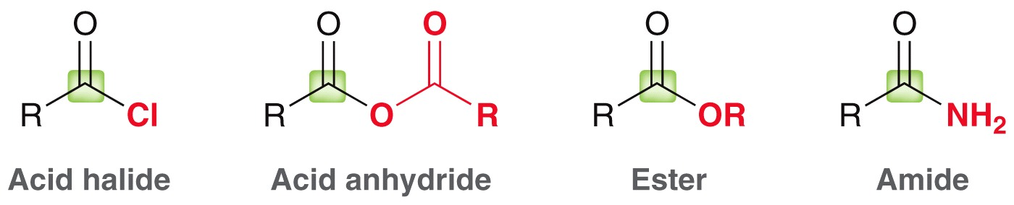
CONVERSION OF CARBOXYLIC ACIDS
Acid derivatives differ in the nature of the nucleophile group bonded to the acyl carbon which actually determines the class of compound:
-OH = carboxylic acid
-Cl = acid chloride
-OR’ = ester
-NH₂ = amide
Carboxylic acid derivatives are compounds with functional groups that can be converted to carboxylic acids by simple acidic or basic hydrolysis.

Slide 25
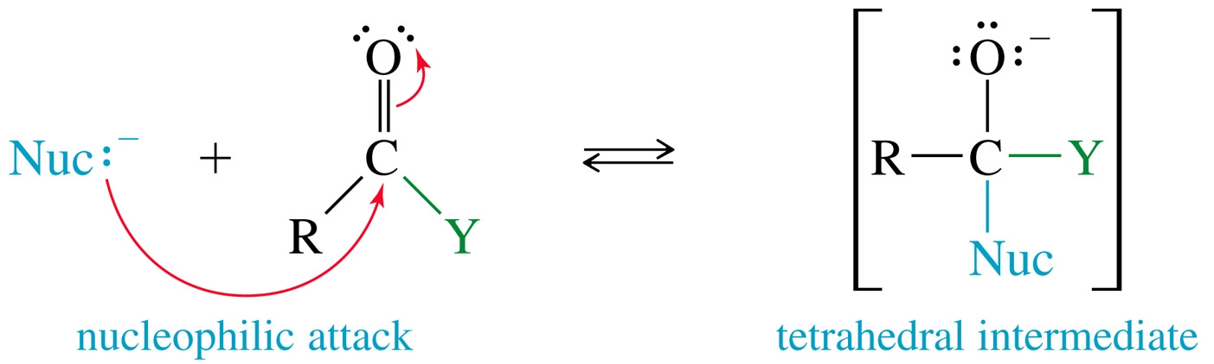
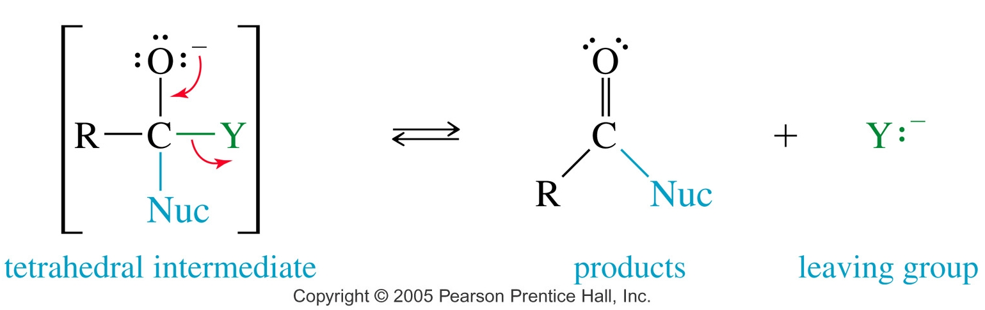
INTERCONVERSION OF ACID DERIVATIVES
Acid derivatives react with a wide variety of nucleophilic reagents under both basic and acidic conditions. Most of these reactions involve nucleophilic acyl substitutions.
Nucleophile adds to the carbonyl to form a tetrahedral intermediate, the leaving group leaves and C=O regenerates.

Slide 26
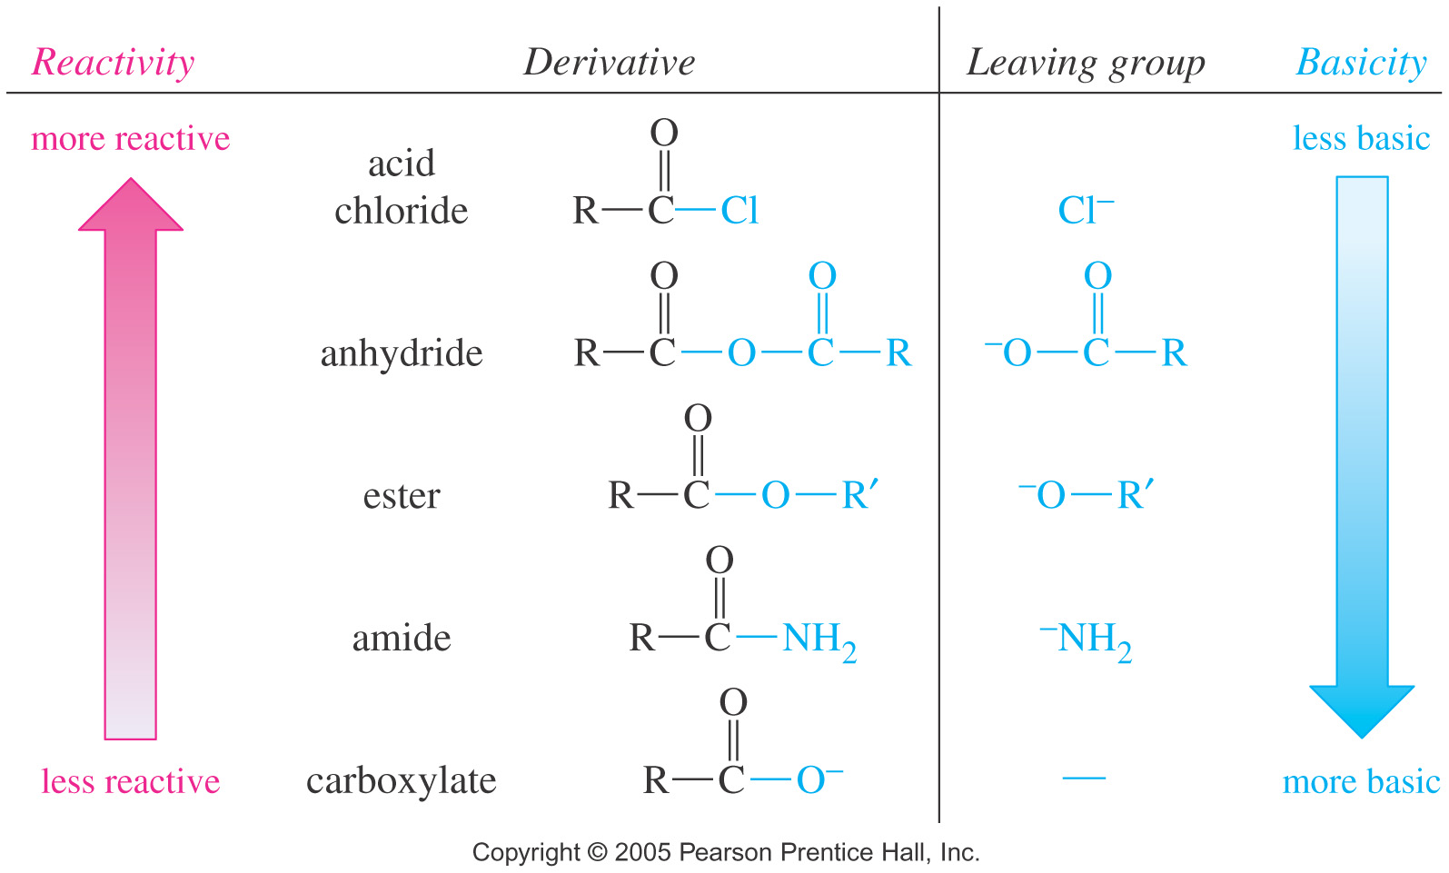
INTERCONVERSION OF ACID DERIVATIVES
Reactivity decreases as leaving group becomes more basic

Slide 27
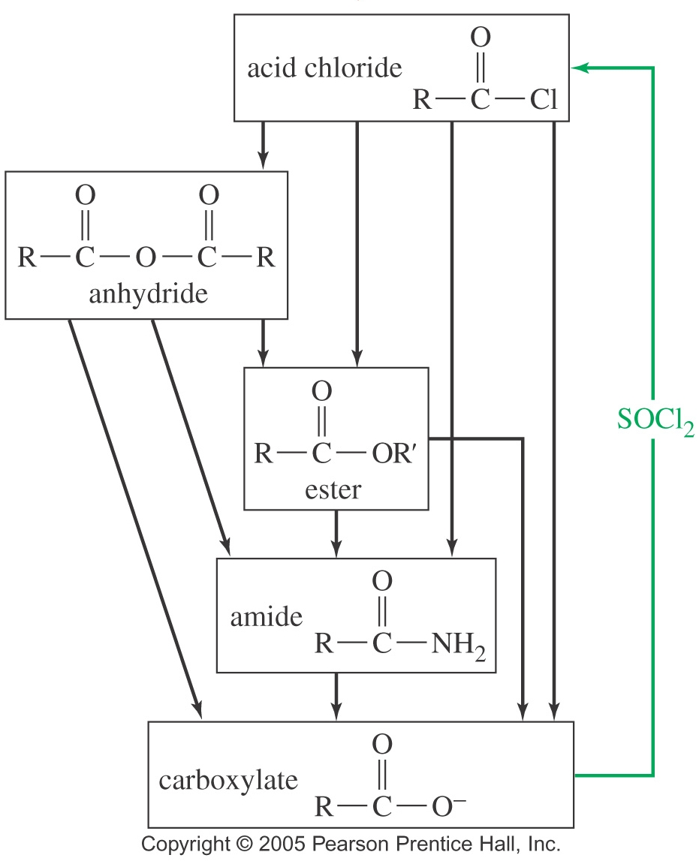
INTERCONVERSION OF ACID DERIVATIVES
Naming Priority
Acids
Acid halides
Esters
Amides
Nitriles
Aldehydes
Ketones
Alcohols
Amines
Alkenes
Alkynes
Alkanes
Ethers
Halides
More reactive derivatives can be converted to less reactive derivatives

Slide 28
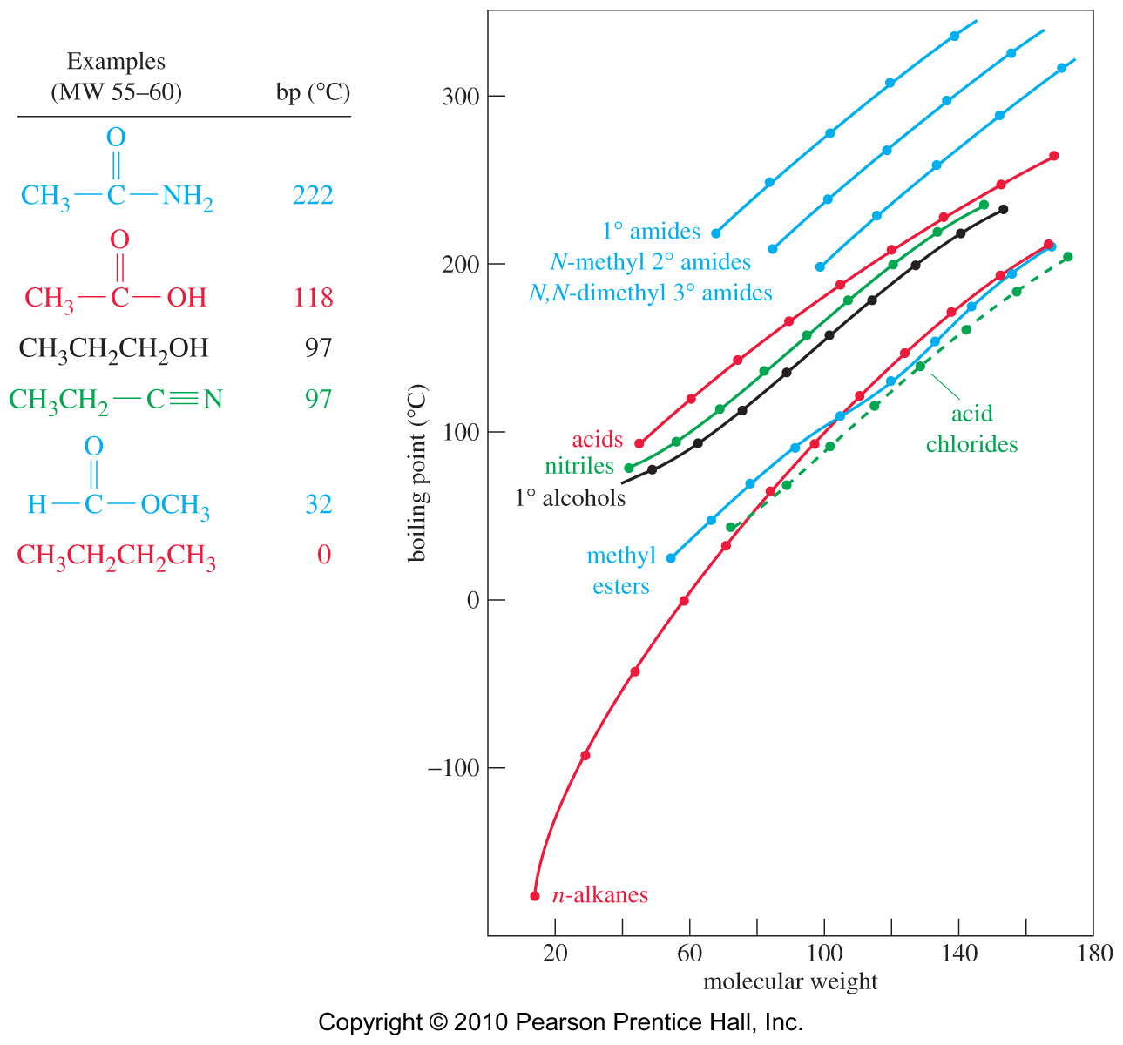
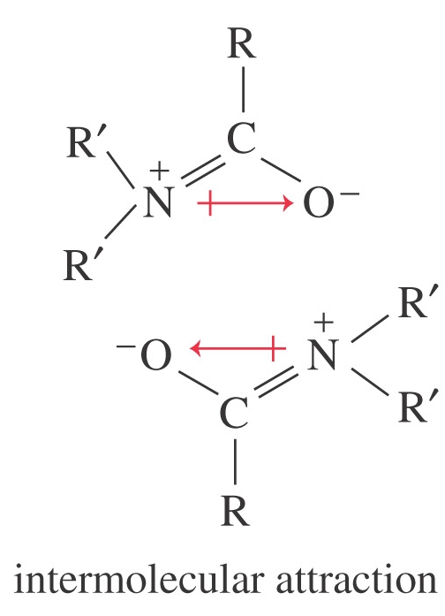
CARBOXYLIC ACID DERIVATIVES
Boiling Points
Even 3° amides have
strong attractions.

Slide 29
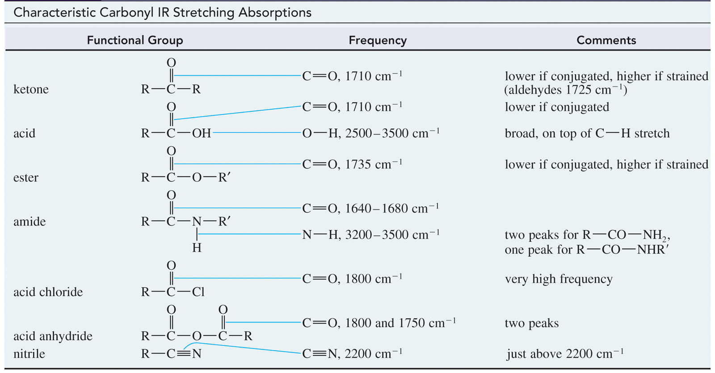
CARBOXYLIC ACID DERIVATIVES
IR Spectroscopy

Slide 30
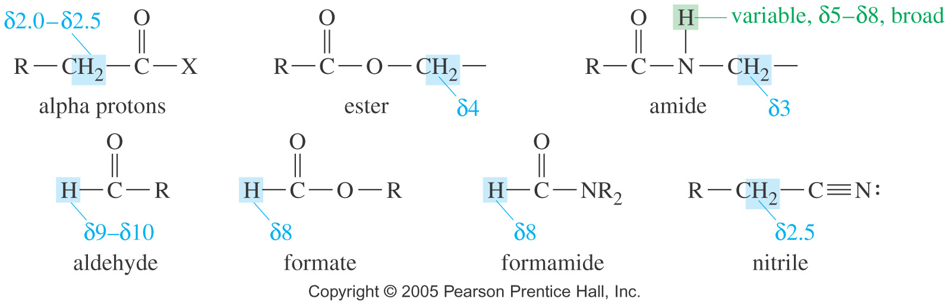
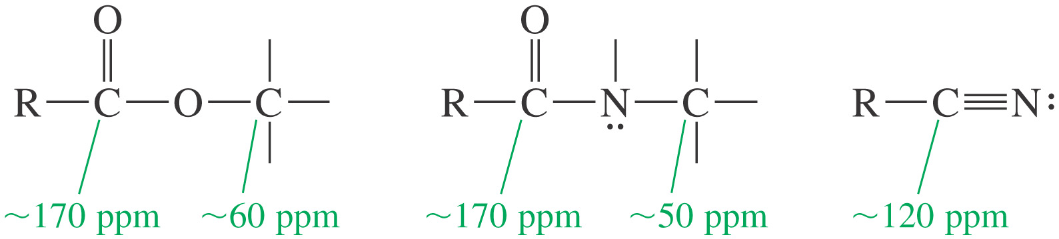
CARBOXYLIC ACID DERIVATIVES
¹H NMR Spectroscopy
¹³C NMR Spectroscopy

Slide 31
ACID HALIDES
Acid halides, also called acyl halides are activated derivatives used for the synthesis of other derivatives of carboxylic acids.
They are named by replacing -ic acid with -yl halide.
Examples: Name the following compounds

Slide 32
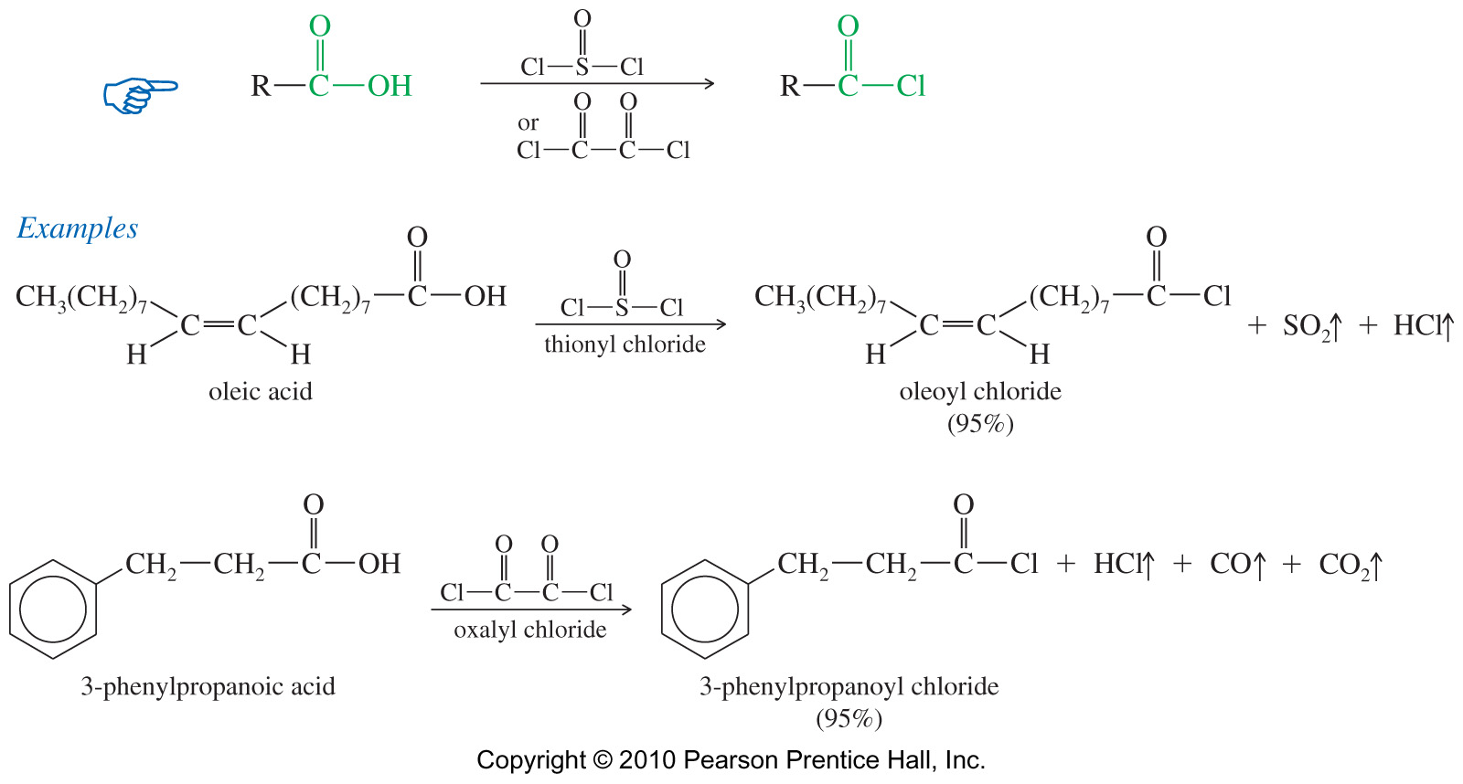
ACID HALIDES
Synthesis of Acid Chlorides
The best reagent for converting carboxylic acids to acid chlorides are thionyl chloride (SOCl₂) and oxalyl chloride (COCl)₂ because they form gaseous by-products that do not contaminate the product.
Thionyl chloride reaction produces SO₂ while the oxalyl chloride reaction produces HCl, CO, and CO₂ (all gaseous).
Synthesis of acid bromide
The best reagent for converting carboxylic acids to acid bromides is phosphorus tribromide (PBr₃)

Slide 33
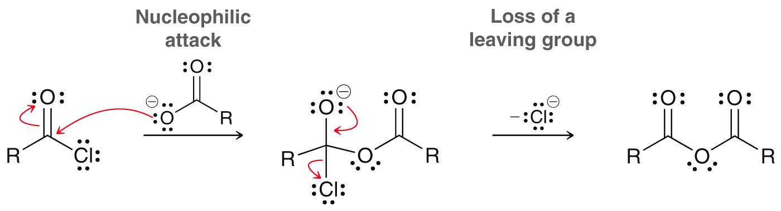
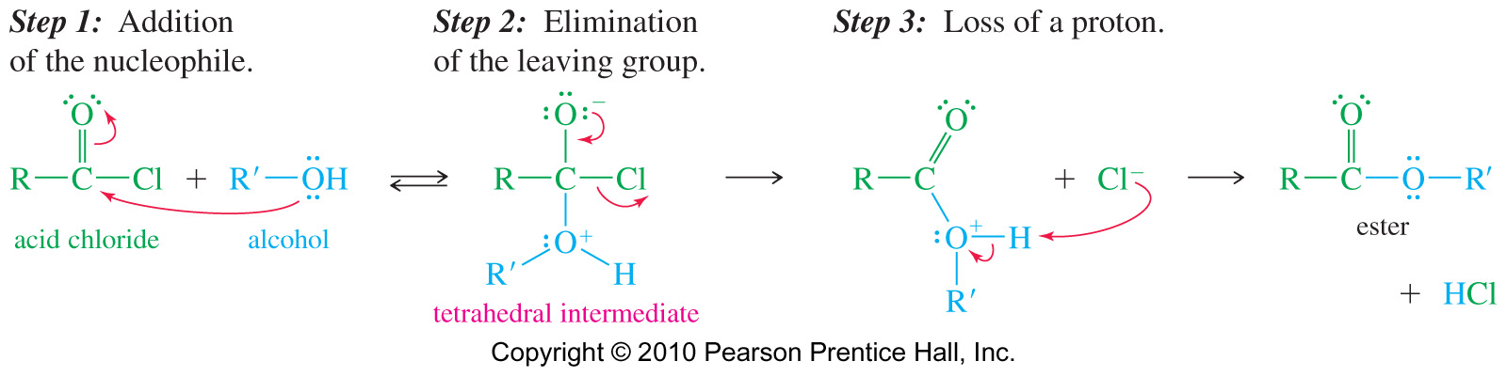
ACID HALIDES
Conversion of Acid Chloride to Anhydride
Conversion of Acid Chloride to Ester

Slide 34
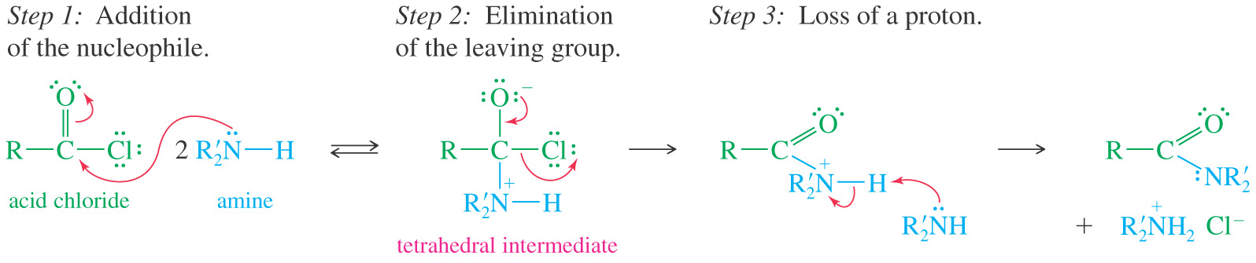
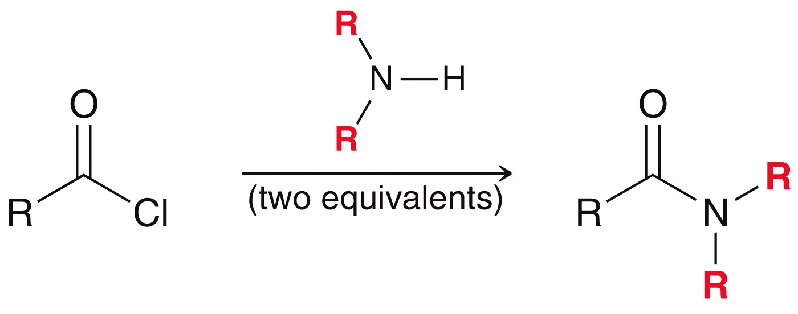
ACID HALIDES
Conversion of Acid Chloride to Amide
Ammonia yields a primary amide
A primary amine yields a secondary amide
A secondary amine yields a tertiary amide

Slide 35
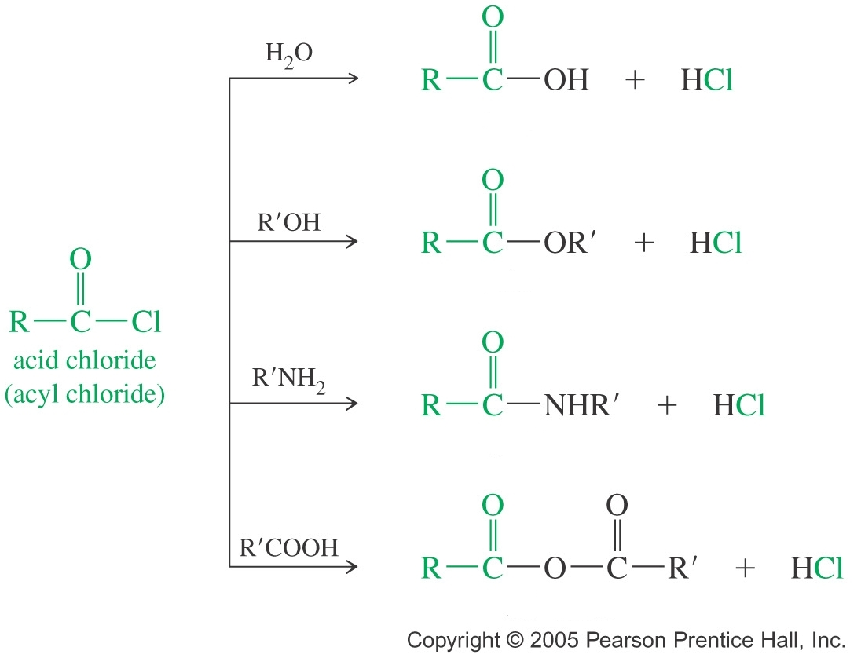
ACID HALIDES
Acid Chloride Reactions (1)
Practice 21.14 to 21.17 P. 1005, 21.18 to 21.20 P. 1010
acid
ester
amide
acid anhydride

Slide 36
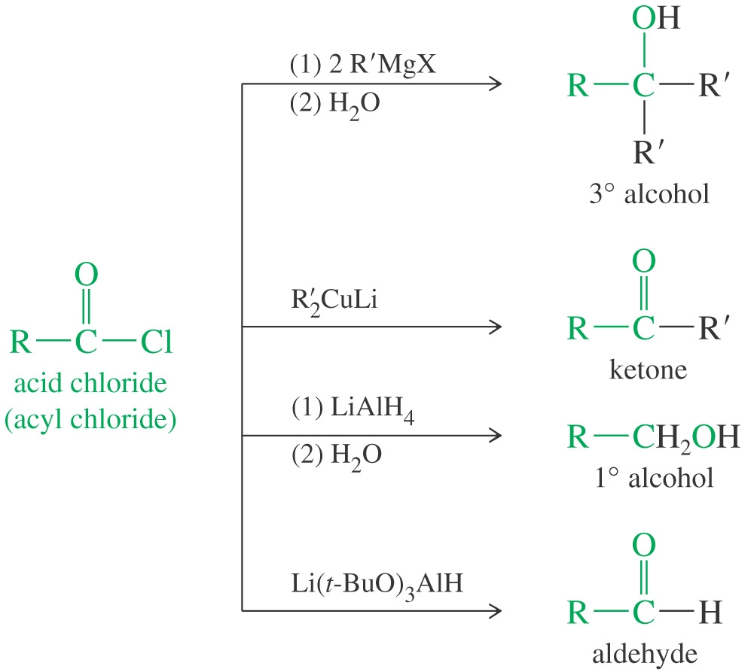


ACID HALIDES
Acid Chloride Reactions (2)
3° alcohol
ketone
1° alcohol
aldehyde
acylbenzene

Slide 37

ACID ANHYDRIDES
The word anhydride means “without water”
Acid anhydrides derive from intermolecular dehydration between two molecules of acid.
Two molecules of acid combine with the loss of water to form the anhydride.
Anhydrides are more reactive than acids, but less reactive than acid chlorides
Naming Anhydrides
The word acid is replaced with anhydride.
For a mixed anhydride, name both acids
Diacids may form anhydrides if a 5- or 6-membered ring is the product.

Slide 38

ACID ANHYDRIDES
Naming Anhydrides
Conversion of Anhydride to Ester
Alcohol attacks one of the carbonyl groups of the anhydride, forming the tetrahedral intermediate. The other acid unit is eliminated as the leaving group

Slide 39


ACID ANHYDRIDES
Conversion of Anhydride to Amide
Ammonia yields a 1° amide
1° amine yields a 2° amide
2° amine yields a 3° amide

Slide 40
ACID ANHYDRIDES
Reactions with cyclic anhydrides
Cyclic anhydrides can also be converted into esters or amides, but the product must keep a carboxylic acid at one of the terminal carbon of the chain.

Slide 41



ACID ANHYDRIDES
Anhydride Reactions
Practice 21.21 P. 1012
acid
ester
amide
AlCl₃
acylbenzene

Slide 42



ESTERS
Nomenclature of Esters
Esters are named as alkyl carboxylates.
The first word is derived from the alkyl group of the alcohol, and the second word from the carboxylate group of the carboxylic acid

Slide 43

ESTERS
Nomenclature of Esters
Name the following compounds
Reaction of —OH and —COOH on same molecule produces a cyclic ester called lactone.
To name, add the word lactone to the IUPAC acid name or replace the -ic acid of common name with –olactone

Slide 44


ESTERS
Synthesis of esters
Esters can be prepared from the carboxylic acid through the Fischer esterification, which is the reaction of a carboxylic acid with an alcohol under acidic conditions produces.
The reaction is an equilibrium, the yield of ester is not high
To drive the equilibrium to the formations of products use a large excess of alcohol

Slide 45


ESTERS
Fischer Esterification Mechanism

Slide 46

ESTERS
Esterification using Diazomethane
Carboxylic acids are converted to their methyl esters very simply by adding an ether solution of diazomethane (CH₂N₂).
Diazomethane is very toxic, and can be explosive.

Slide 47



ESTERS
Mechanism for Diazomethane esterification

Slide 48



ESTERS
Hydrolysis of Esters: Saponification
The base-catalyzed hydrolysis of ester is known as saponification.
Saponification means “soap-making”

Slide 49

ESTERS
Saponification
Soap usually reacts with hard water to form Soap scum. Hard water contains calcium, magnesium and iron ions, which generally react with the fatty acid component of soap to give a precipitate
2 C₁₇H₃₅COO⁻Na⁺ + Ca²⁺ → (C₁₇H₃₅COO)₂Ca + 2 Na⁺

Slide 50

ESTERS
Detergents

Slide 51

ESTERS
Conversion of Ester to Amide: Ammonolysis
Nucleophile must be NH₃ or 1° amine.
Prolonged heating is required
A strong base, such as methoxide (-OCH₃), is not usually a leaving group, except in an exothermic step.

Slide 52
ESTERS
Preparation of Lactones (cyclic esters)
Simple lactones containing five- or six-membered rings are often more stable than the open-chain hydroxy acids.
Larger rings are often less stable, water most be trapped during the reaction to shift equilibrium toward products.

Slide 53
ESTERS
Reactions with cyclic esters
Cyclic esters (or lactones) can also be converted into open-chain esters or amides, but the product must keep an hydroxyl functional group at one of the terminal carbon of the chain.

Slide 54

ESTERS
Reactions of Esters
Practice 21.22 P. 1014, 21.24, 21.25 P. 1020
acid
ester
amide
1° alcohol
3° alcohol

Slide 55
ESTERS
Esters as flavoring agents
Flavoring agents are the largest class of food additives. The majority of these are concentrates or extracts from material whose flavor is desired. Many of them are major components of natural flavors, and adding only one or few of them is sufficient to make ice cream, soft drinks, or cadies…

Slide 56

ESTERS
Thioesters
Most carboxylic esters are composites of carboxylic acids and alcohols. Thioesters are formed from carboxylic acids and thiols.
They are more reactive than esters toward nucleophilic substitution because:
-S-R is a better leaving group than -O-R
Resonance overlap is not as effective

Slide 57

AMIDES
Naming Amides
For amide, drop -ic or -oic acid from the carboxylic acid name, add -amide.
Alkyl groups bonded to nitrogen are named with N-alkyl to indicate their attachment to the nitrogen atom
Samples: Name the following compounds

Slide 58

AMIDES
Naming Cyclic Amides
Cyclic amides are called lactams.
To name, add the word lactam to the IUPAC acid name or replace the -ic acid of common name with -olactam

Slide 59

AMIDES
An amide is a composite of a carboxylic acid and ammonia or an amine.
They are not basic because the lone pair on nitrogen is delocalized by resonance
1° amide has one C—N bond (two N—H).
2° amide or N-substituted amide has two C—N bonds (one N—H)
3° amide or N,N-disubstituted amide has three C—N bonds (no N—H).

Slide 60

AMIDES
Synthesis of Amides
The initial reaction of a carboxylic acid with an amine gives an ammonium carboxylate salt
Heating this salt to well above 100° C drives off steam and forms an amide

Slide 61




AMIDES
Hydrolysis of Amides
Amides hydrolyze to carboxylic acids under both acidic and basic conditions
Prolonged heating in 6 M HCl or 40% aqueous NaOH is required

Slide 62

AMIDES
Reduction to Amines
Amides will be reduced to the corresponding amine by LiAlH₄

Slide 63

AMIDES
Lactam Formation (cyclic amides)
Five-membered lactams (γ-lactams) and six-membered rings (δ-lactams) often form upon heating or adding a dehydrating agent to the appropriate γ- or δ-amino acids.
Smaller or larger rings do not form readily under these conditions

Slide 64
AMIDES
Reactions with cyclic amides
Cyclic amides (or lactams) can also be converted into open-chain esters or amides, but the product must keep an amino functional group at one of the terminal carbon of the chain.

Slide 65
AMIDES
β-Lactams
β-Lactams are unusually reactive amides and are capable of acylating a variety of nucleophiles. The considerable strain on the four-membered ring appears to be the driving force behind this unusual reactivity.
The β-Lactam ring is often found in antibiotics isolated from fungi such as penicillins, cephalexin and imipenem
β-Lactams exert lethal effects on bacteria by interacting with some, but not all, penicillin binding proteins (PBP)

Slide 66


AMIDES
Mechanism of β-Lactam Acylation
β-Lactams
The β-lactams work by interfering with the synthesis of bacterial cell walls
The acylated enzyme is inactive for synthesis of the cell wall protein

Slide 67

AMIDES
Reactions of Amides
Practice 21.16 to 21.28 P. 1023
acid and amine
amine
1° amine
nitrile

Slide 68




NITRILES
Nitriles contain the cyano group (—C≡N)
They can be hydrolyzed to carboxylic acids

Slide 69

NITRILES
Mechanism – Preparation of nitrile using thionyl chloride

Slide 70


NITRILES
Nitrile hydrolysis
Acidic hydrolysis
Basic hydrolysis
Naming Nitriles
For IUPAC names, add -nitrile to the alkane name
Common names come from the carboxylic acid. Replace -ic acid with -onitrile

Slide 71

NITRILES
Reduction of Nitriles to Primary Amines
Nitriles are reduced to primary amines by catalytic hydrogenation or by lithium aluminum hydride reduction
A Grignard reagent or organolithium reagent attacks the cyano group to yield an imine, which is hydrolyzed to a ketone

Slide 72

NITRILES
Reactions of Nitriles
Practice 21.29, 21.30 P. 1027

Slide 73


ACID DERIVATIVES POLYMERS
Polyesters
Polyesters are commonly used to make clothes, plastic bottles, floppy disks and VCR tape etc…
Proteins

Slide 74


ACID DERIVATIVES POLYMERS
Polyamides (Nylon)
The discovery of nylon in 1938 made possible a wide range of high-strength fibers, fabrics and platics

Slide 75
ACID DERIVATIVES POLYMERS
Carbonic Acid Esters
Carbonic acid (H₂CO₃) is formed when CO₂ dissolves in water. Although carbonic acid itself is always in equilibrium with carbon dioxide and water, it has several stable derivatives. Carbonate esters are stable diesters of carbonic acid synthesized from phosgenes.
Industrially, phosgene is produced by passing purified carbon monoxide and chlorine gas through a bed of porous activated carbon, which serves as a catalyst. The equation is described as follows
Phosgene is a colorless gas that gained infamy as a chemical weapon during World War I. In low concentrations, its odor resembles freshly cut hay or grass.
In addition to its industrial production, small amounts occur naturally from the breakdown of chlorinated compounds and the combustion of chorine-containing organic compounds.

Slide 76

ACID DERIVATIVES POLYMERS
Polycarbonates
Polycarbonate are long-chain esters of carbonic acid.
Polycarbonates are a particular group of thermoplastic polymers
They are easily worked or thermoformed, thus they are widely used in the modern industries

Slide 77

ACID DERIVATIVES POLYMERS
Polyurethanes
Polyurethanes are produced from reactions between diols and diisocyanates.
They are widely used in high resiliency flexible foam seating, rigid foam insulation panels, microcellular foam seals and gaskets, durable elastomeric wheels and tires, automotive suspension bushings, electrical potting compounds, high performance adhesives and sealants, fibers, seals, carpet underlay, and hard plastic parts.
Practice 21.32 P. 1029, 21.35, 21.37 P. 1032
Problems 21.45 to 21.54, 21.65, 21.73 P1038 - 1041

